Slide 1

DATA Aces
INTERNSHIP REVIEW
OJASHWEE RAMAN

Slide 2

Courses
Introduction to ChatGPT
Features
Prompts(Content, Knowledge, Translation)
Limitations
Prompt Engineering and Advanced ChatGPT
Applications in various industries
Integrating ChatGPT with other tools and technologies(NLP, ML -- Chatbots)
How to Use ChatGPT in Business
Transformation of business operations.
Decision-making and strategy development.

Slide 3
Task
Open SOURCE AI MODELS
Explored various open source AI models(BERT, GPT, YOLO, DeepFace, Tacotron + WaveGAN)
Classification of datasets – I, ii & III
FuzzyWuzzy string matching approach
Multinomial Naive Bayes classifier using content and categories, then uses it to predict categories for descriptions.
API + Payload (MeaningCloud)
API setup
Payload setup
API request
Response in Json

Slide 4
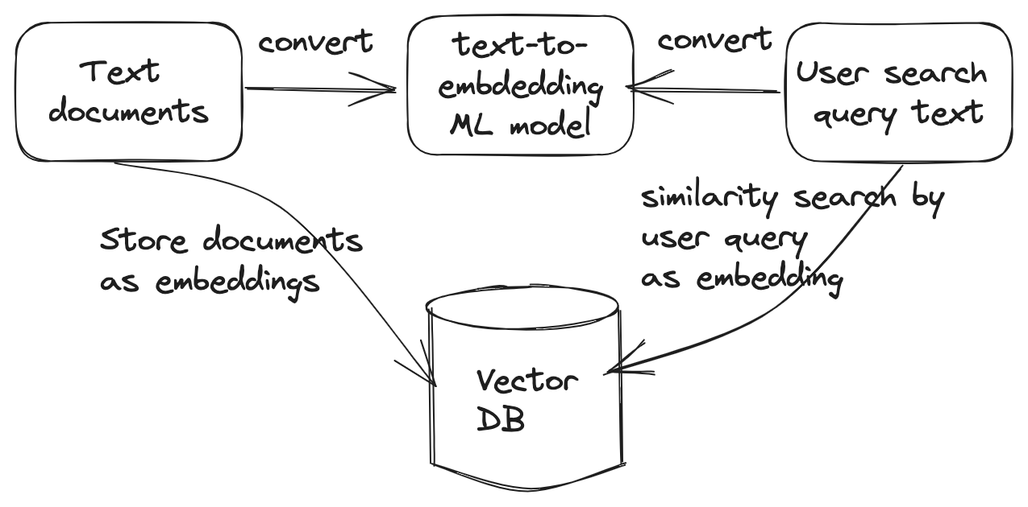
Vector search chatbot
Objective:
The code implements a simple news chatbot using the Langchain library for natural language processing.
The objective is to create a conversational interface where users can ask questions about the news, and the chatbot retrieves relevant information from a pre-existing ChromaDB collection.
Packages Used:
langchain: The code leverages the Langchain library, specifically the Document class for handling natural language documents.
chromadb: ChromaDB is employed to store and query news-related data.

Slide 5
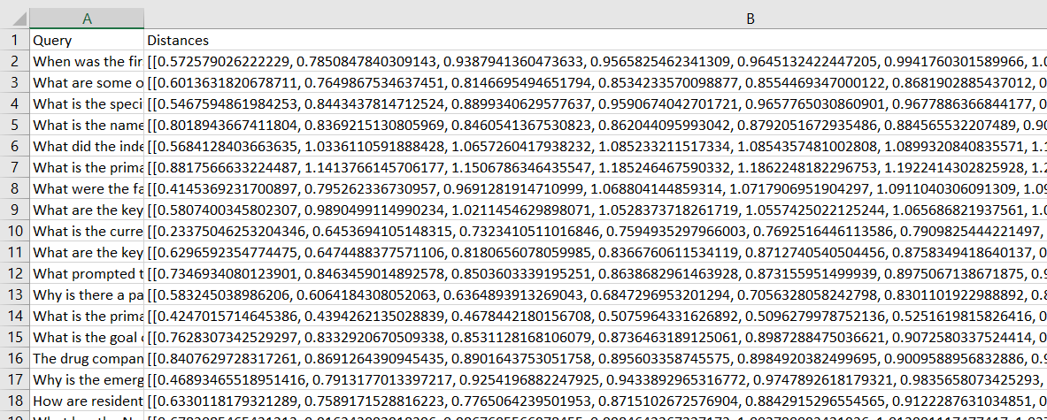
Task – Chatbot Testing
Objective
The implementation aims to calculation of L2 distance for a entered search query.
The primary objective is to measure the similarity between the query and documents in the 'news' collection based on their vector representations.
Report preparation.
Packages Used
chromadb: The ChromaDB library is employed for interacting with the ChromaDB vector store. The HttpClient establishes a connection to the ChromaDB server, and the get_collection method is utilized to access the 'news' collection.
Testing Parameters
Difficulty/Text size
Numerical/Special character based
How/Wh queries

Slide 6
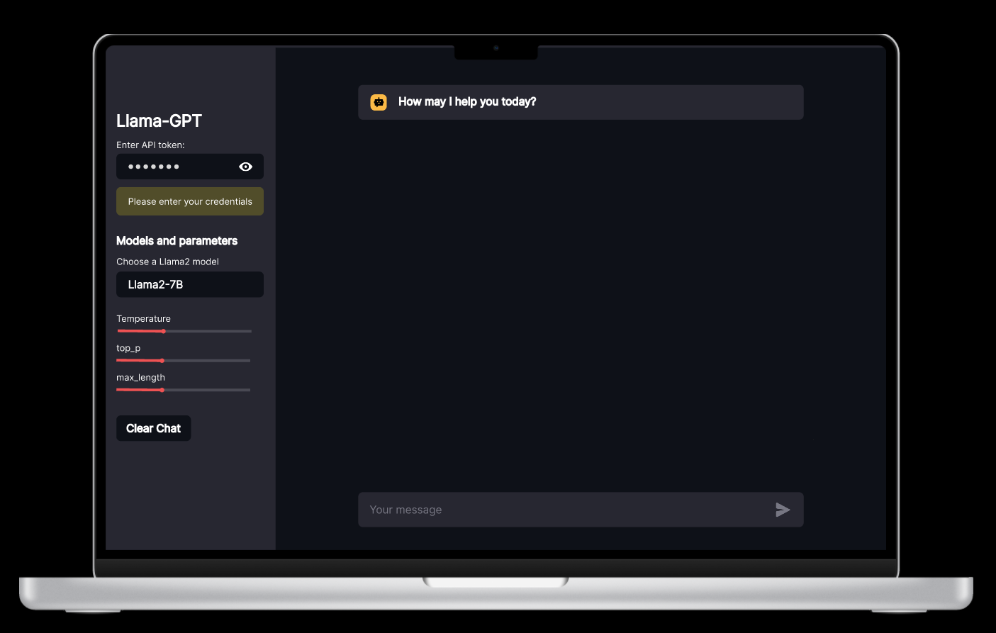
Llama chatbot
Features:
Flexible API Key Integration: Users can input their own API key, ensuring a personalized and secure interaction with the chatbot.
Model Selection Options: Users can choose from a range of Llama models, including llama2-7B, llama2-14B, and llama2-70B, aligning with their subscription plans.
Tailored Output Control: The chatbot empowers users to customize generated results by specifying output length and setting parameters for relevancy.
Use Cases:
Temperature: Temperature controls the randomness of the generated text.
Top_p: Top-p, also known as nucleus sampling, controls the diversity of the generated responses.
Max length: Max length determines the maximum number of tokens in the generated output.
Clear Chat: Clears Chat

Slide 7
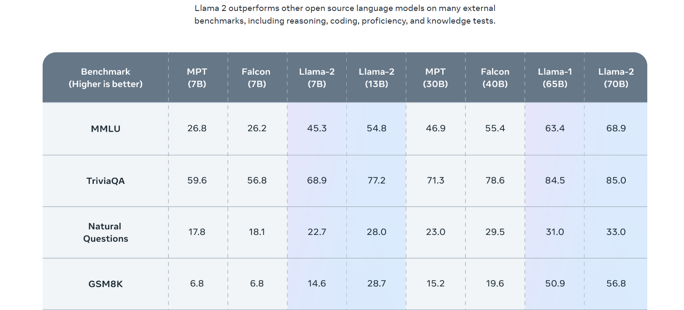
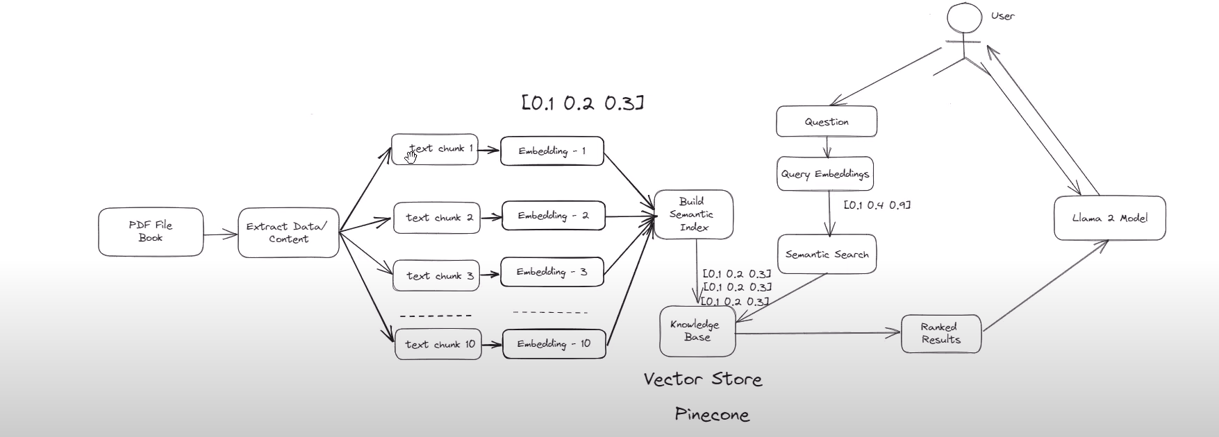
Llama pdf search
Objective
Model Used: Llama-2-7b-chat-hf(not finetuned for chat or Q&A)
An AI chatbot designed to efficiently extract information from PDF documents based on user queries. The chatbot enables users to ask question from uploaded PDFs.
Packages Used:
langchain: A library facilitating natural language processing, offering tools for document loading, text splitting, embeddings, and integration with vector stores like Pinecone.
pinecone-client: A Python client for Pinecone, a vector database service for efficient similarity search and retrieval of embeddings.
sentence_transformers: A library providing pre-trained models for generating sentence embeddings, enabling semantic similarity computations in NLP tasks.
pypdf: A library for parsing PDF documents, allowing programmatic access to content and metadata.

Slide 8
THANK YOU
OJASHWEE RAMAN
+91 - 9693592086
r.ojashwee23@gmail.com
LinkedIn - Ojashwee Raman

